Slide 1


Front End Web Development, React Js
Presented By
Supervised By
Md. Abu Rumman Refat
Lecturer
Dept. of Computer Science of Engineering
Green University of Bangladesh
Md. Jahid Hasan Pintu
ID: 201002001
Green University of Bangladesh
Industrial Supervisor
Nadim Mahmud
Fullstack Developer
Eclassmate
Department of Computer Science of Engineering
Green University of Bangladesh
01

Slide 2
01
07
Introduction
Tools and Techniques
Outlines
02
08
Motivation for the Training
Technological Changes
03
09
Training Objectives
Application UI
04
10
Organizational Overview & Setup
Conclusion
05
Problem Statements
06
Analyzing and Providing Solutions
02

Slide 3

Introduction
Working Experience
Skill Development
Networking Opportunities
Resume Enhancement
Exploration of Career Paths
03

Slide 4
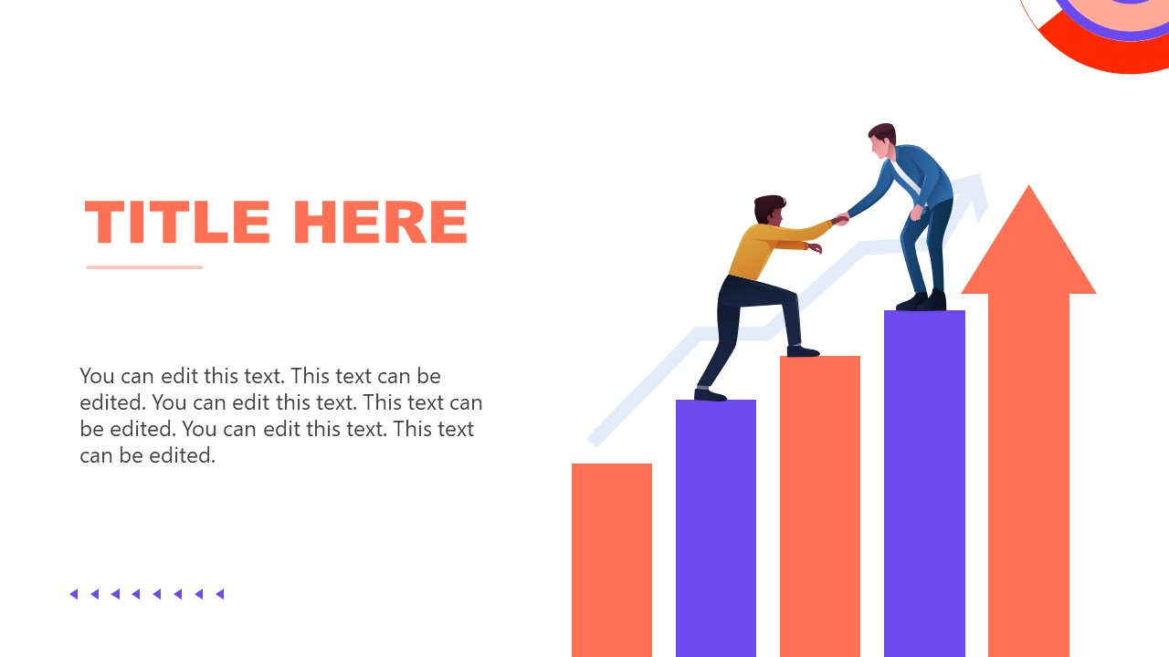
Motivations
Working contributes to real-world projects
Recognition and Responsibility
Learning to practical situations
Understand industry level working
Gathering Professional Growth
04

Slide 5
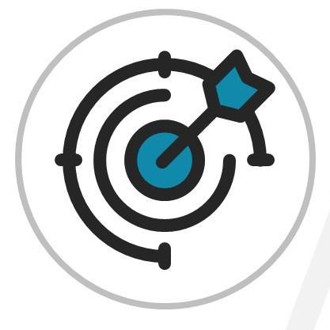
Objectives
Close the knowledge gap between academic theory and industry demands.
Fully immersed in real-world networking
Create career opportunity
Acquire deferent type of skill and knowledge
Participate actively in projects and tasks that are relevant to the real world
05

Slide 6
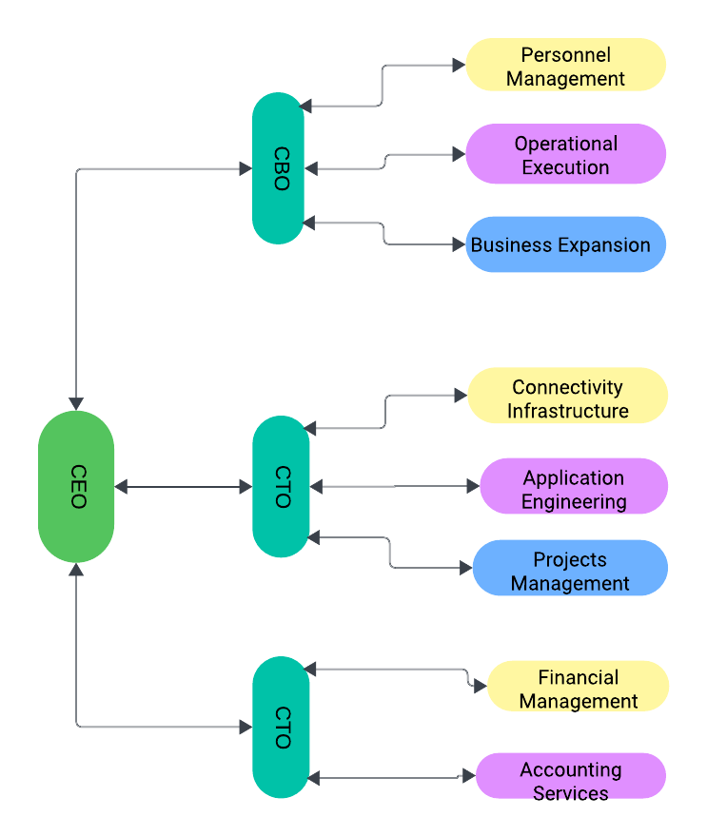
Organizational Overview & Setup
Establishment and Vision:
Eclassmate is a rising ed-tech startup in Bangladesh. It Founded in 2020.
Digital Education Platform:
Addresses challenges with traditional education methods through a digital platform.
Educational Vision and Impact:
Dedicated to excellence, honesty, teamwork, innovation, and customer happiness.
CFO
Figure 1: Organizational Setup
06

Slide 7

Problem Statements
Develop a front end part of web application
Problem Statement: Given an figma template to convert it into react js
Responsive Design:
Problem Statement: Design the interface of the application for mobile view.
State Management Integration:
Problem Statement: Integrate Redux into a React application for efficient state management. Apply it to handle complex data and interactions, enhancing the overall user experience.
07

Slide 8

Problem Solutions
Effective use of SPA
Git uses for Collaboration
Optimized Code Structuring
Reliable Team work
Knowledge Sharing
08

Slide 9










Tools and Techniques
Figma:
HTML
Collaborative design tool for creating user interfaces and prototypes, streamlining the design-to-development process.
HTML (HyperText Markup Language):
Markup language for structuring content on the web, defining elements and their hierarchy.
Visual Studio Code:
CSS (Cascading Style Sheets)
Lightweight, extensible code editor with features like debugging, syntax highlighting, and Git integration.
Stylesheet language controlling the presentation of HTML elements, enhancing visual design and layout.
Redux:
Tailwind CSS:
State management library for JavaScript applications, ensuring predictable state changes in complex applications.
Utility-first CSS framework facilitating rapid development through pre-defined classes for styling.
JavaScript:
React:
Programming language enabling dynamic behavior on web pages, enhancing interactivity and responsiveness.
JavaScript library for building user interfaces, allowing efficient creation of reusable UI components.
09

Slide 10

Technological Changes
Encouraged open teamwork and clear communication within the group.
Bounced back from challenges, turning failures into learning opportunities.
Explored new tech like Firebase, React.js, Redux, and Git,
Discovered solutions when dealing with coding challenges.
10

Slide 11
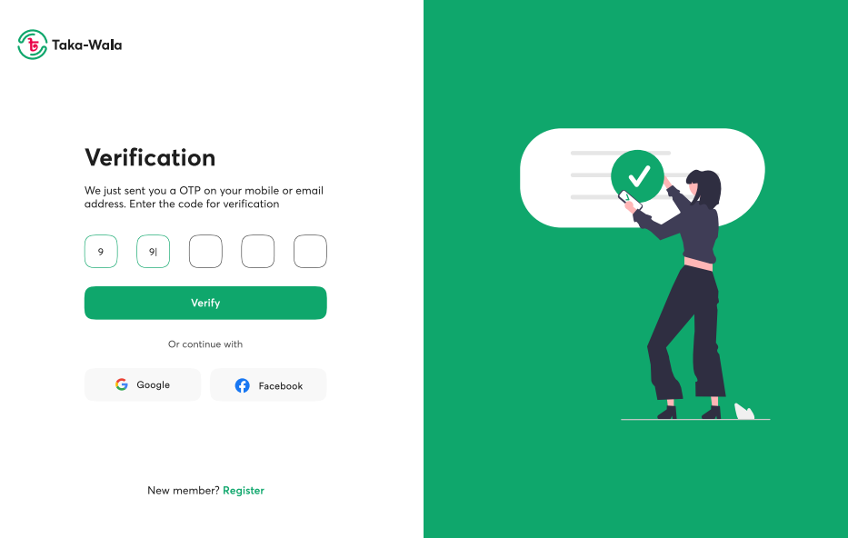
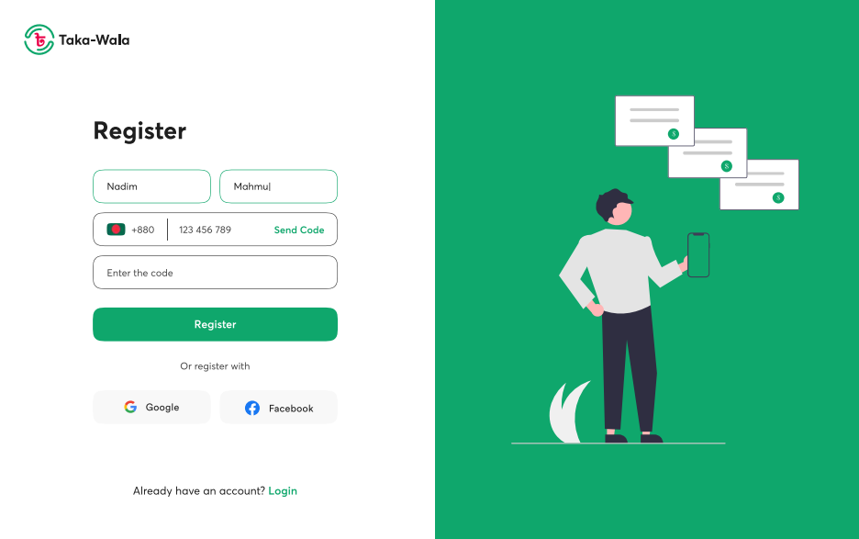
Application UI
Figure 2: Register Interface
Figure 3: Verification Interface
11

Slide 12

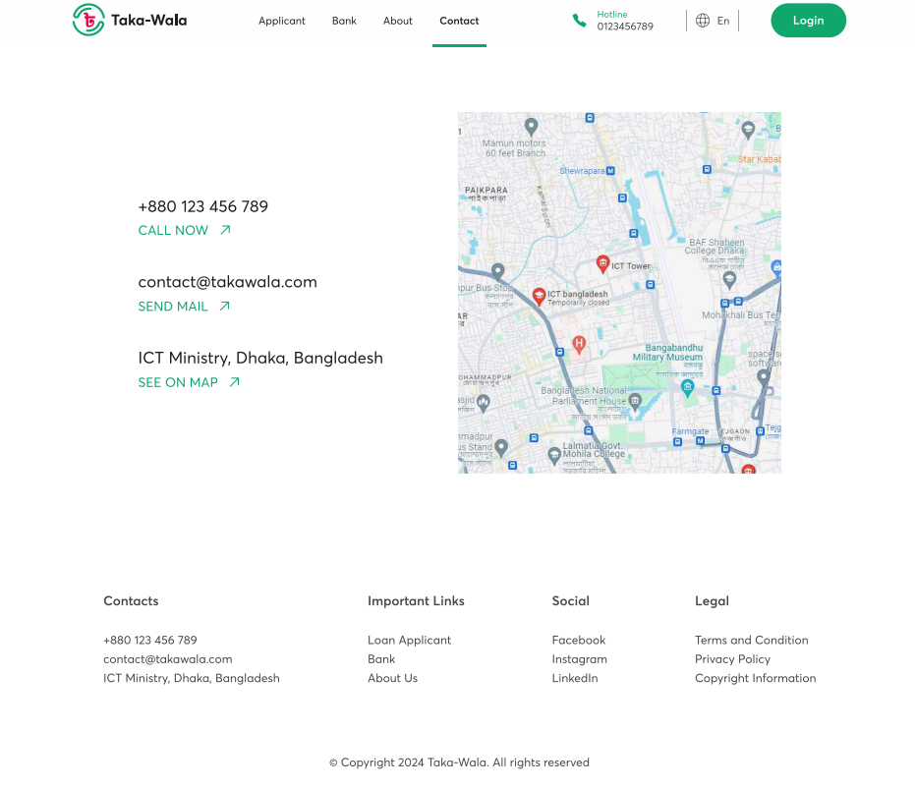
Application UI (Cont.)
Figure 3: Login Interface
Figure 4: Contact Interface
12

Slide 13
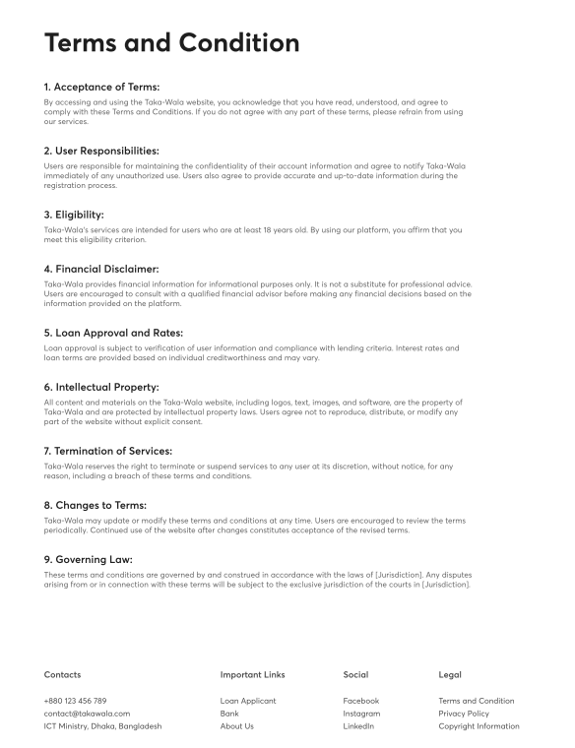
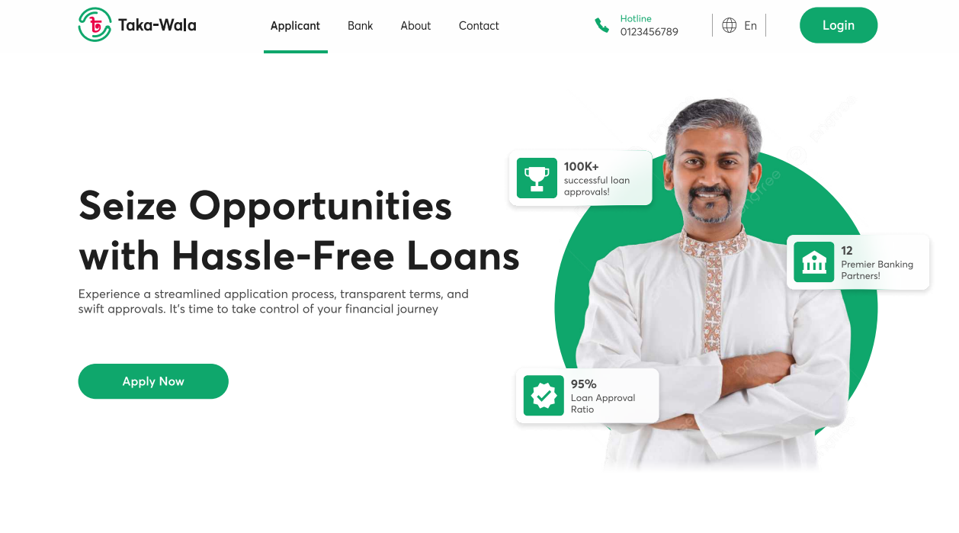
Application UI (Cont.)
Figure 5: Landing Page
Figure 4: Terms and Condition Interface
13

Slide 14

Conclusions
Strengthened skills in frontend web development during Eclassmate internship.
Mastered key technologies and addressed diverse challenges.
Gained practical experience in crafting dynamic web applications.
Inspired to continually expand skills and apply expertise for positive contributions to software development.
14

Slide 15
References
[1] eclassmate. Eclassmate. https://eclassmate.com.bd/. Accessed: 2024-03-04.
[2] Abdullah Tahmid Rafi. A study on survey level of eclassmate. 2022.
[3] MDN Web Docs. Html: Hypertext markup language. https://developer.
mozilla.org/en-US/docs/Web/HTML. Accessed: 2024-03-04.
[4] Chris Coyier. A complete guide to flexbox. https://css-tricks.com/
snippets/css/a-guide-to-flexbox/. Accessed: 2024-03-04.
[5] MDN Web Docs. Css: Cascading style sheets. https://developer.mozilla.
org/en-US/docs/Web/CSS. Accessed: 2024-03-04.
[7] Tailwind Labs. Tailwind css documentation. https://tailwindcss.com/docs.
Accessed: 2024-03-04.
[8] Ilya Kantor. The modern javascript tutorial. https://javascript.info/. Accessed: 2024-03-04.
[9] W3Schools. Javascript es6. https://www.w3schools.com/js/js_es6.asp.
Accessed: 2024-03-04.
[10] React Team. React - a javascript library for building user interfaces. https:
//reactjs.org/. Accessed: 2024-03-04.
15

Slide 16
THANK YOU
16

Slide 17

Q & A Session
17

